Slide 1

MRI
HW3-fMRI
Presenter：
M11107309 何柏昇

Slide 2

OUTLINE
fMRI Analysis
Introduction
Method
Experimental Results

Slide 3
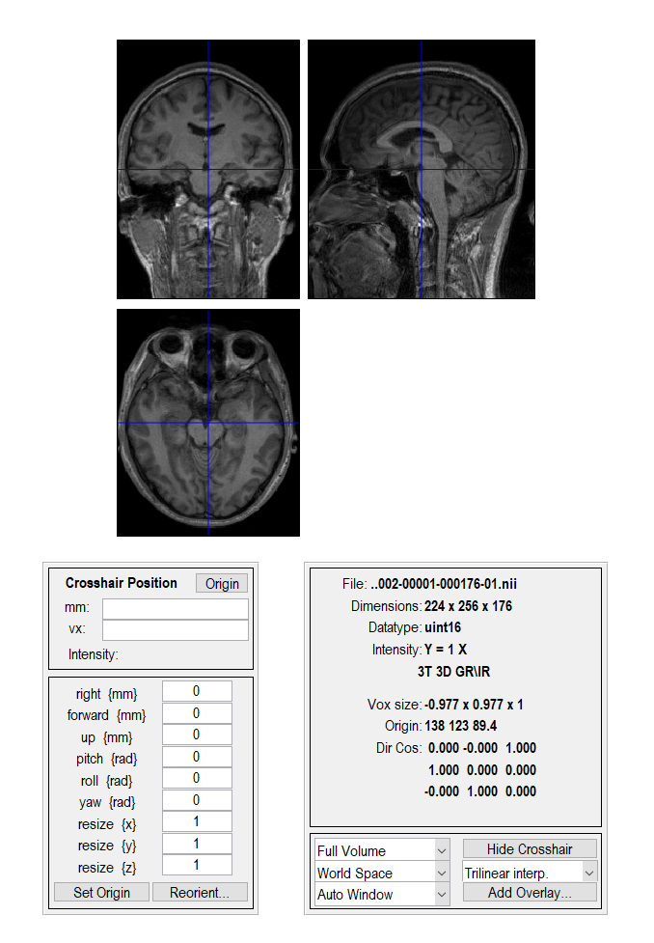
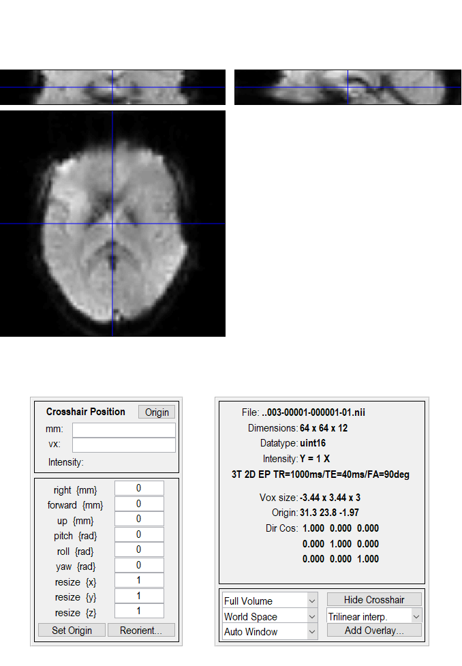
Introduction - Data
T1: 高解析度3D T1資料
fMRI: 實驗過程共100次掃描，受試者動作過程如下： 20off_20on_20off_20on_20off
T1
fMRI

Slide 4
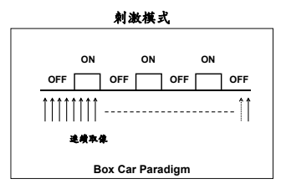
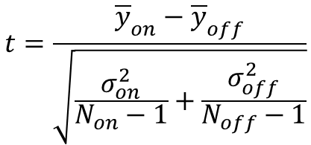
Introduction - Analysis of fMRI
Direct Subtraction (DS)
全部刺激後平均 – 全部刺激前平均
$$t=\frac{{\overline{y}}_{on}−{\overline{y}}_{off}}{\sqrt{\frac{σ_{on}^{2}}{N_{on}−1}+\frac{σ_{off}^{2}}{N_{off}−1}}}$$
Analysis of Functional MRI Data Using Mutual Information

Slide 5
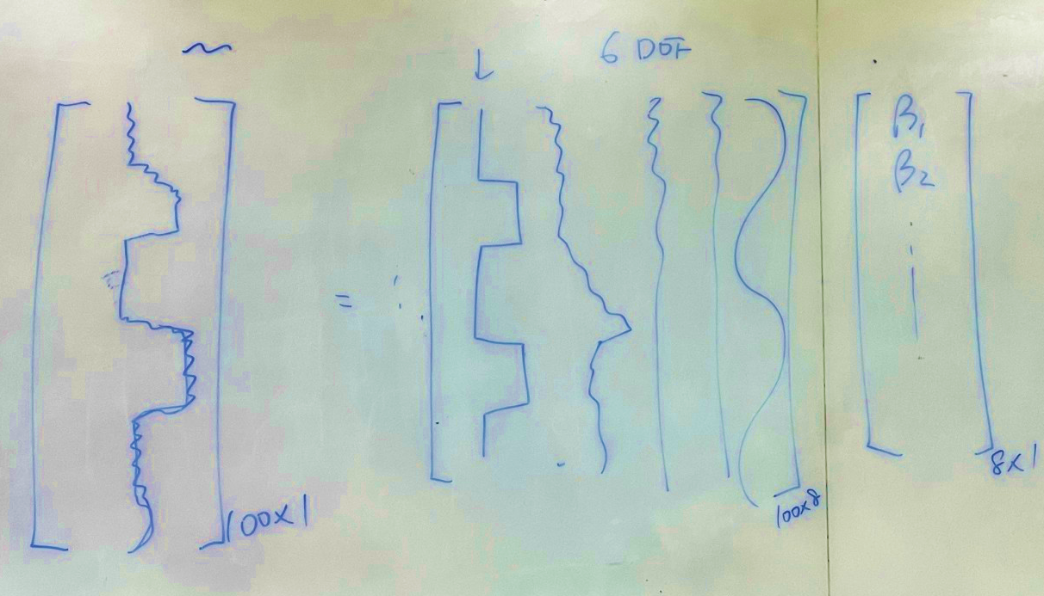
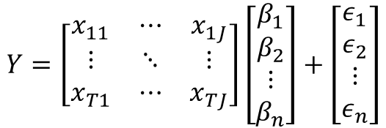
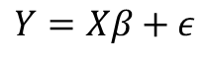
Introduction - Analysis of fMRI
General Linear Model (GLM)
$$Y=Xβ+ε$$
$$Y=\left[\begin{matrix}x_{11} & ⋯ & x_{1J} \\ ⋮ & ⋱ & ⋮ \\ x_{T1} & ⋯ & x_{TJ}\end{matrix}\right]\left[\begin{aligned}β_{1} \\ β_{2} \\ ⋮ \\ β_{n}\end{aligned}\right]+\left[\begin{aligned}ε_{1} \\ ε_{2} \\ ⋮ \\ ε_{n}\end{aligned}\right]$$
Analysis of Functional MRI Data Using Mutual Information

Slide 6
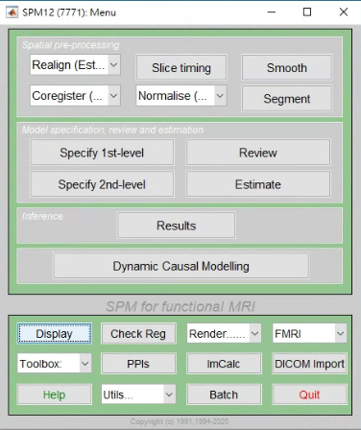
Method
SPM
Load T1 and fMRI(EPI) files: DICOM to nil
Slice Timing
Realign: Estimate & Reaslice
Coregister: Estimate
Normalise: Estimate and Write
Smooth
fMRI Model Specification
Model Estimation
Result Review
國立陽明大學-功能性磁振影像分析

Slide 7
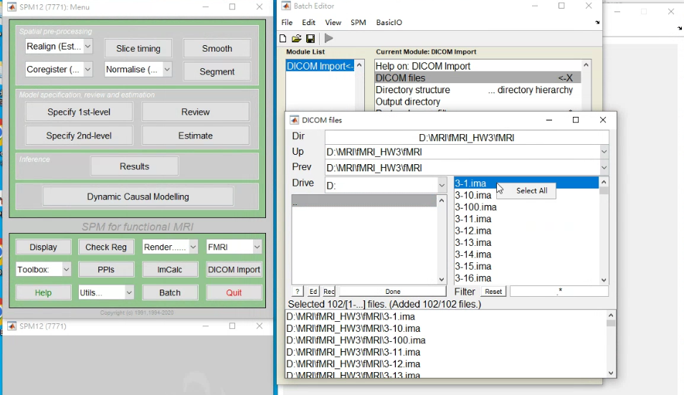
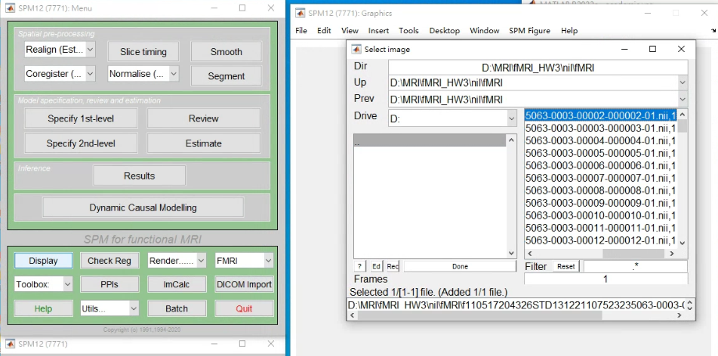
Method
Load files
DICOM ➔ Nil

Slide 8
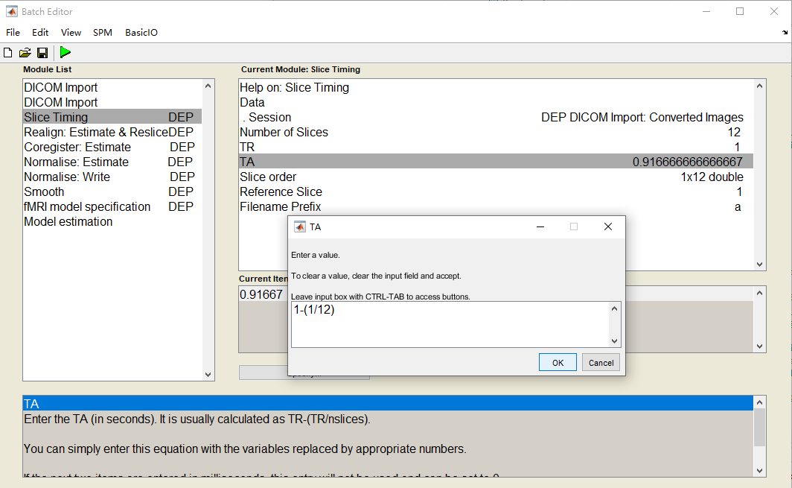
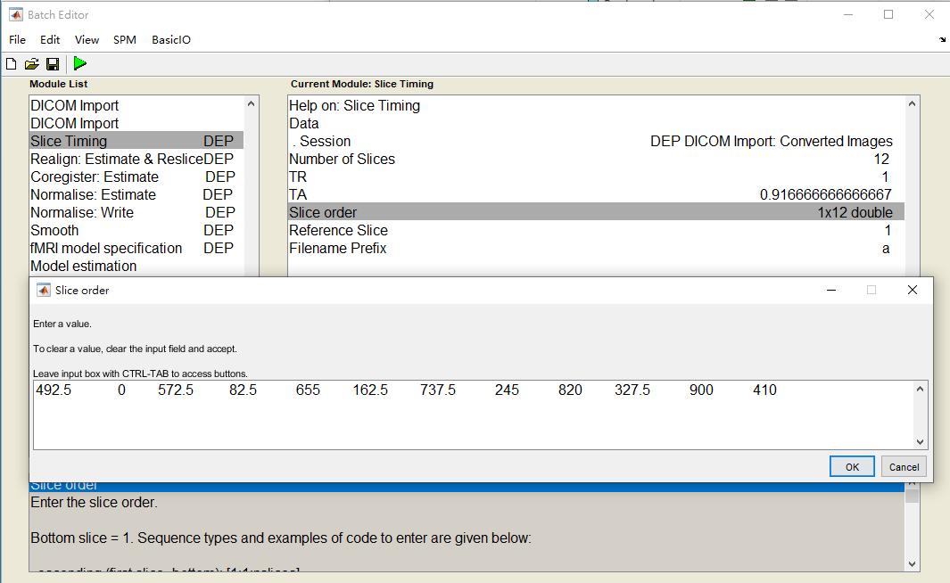
Method
Slice Timing

Slide 9
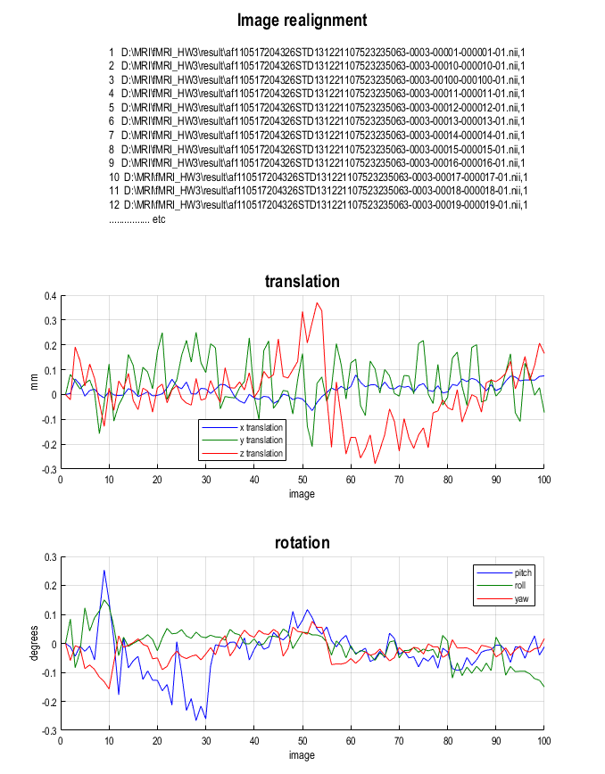
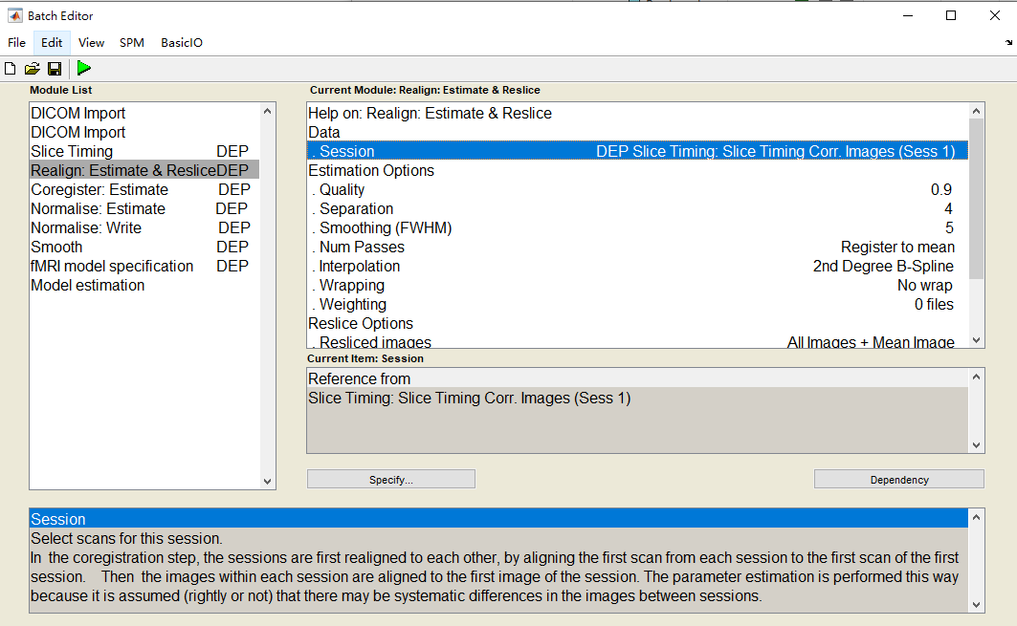
Method
Realign

Slide 10
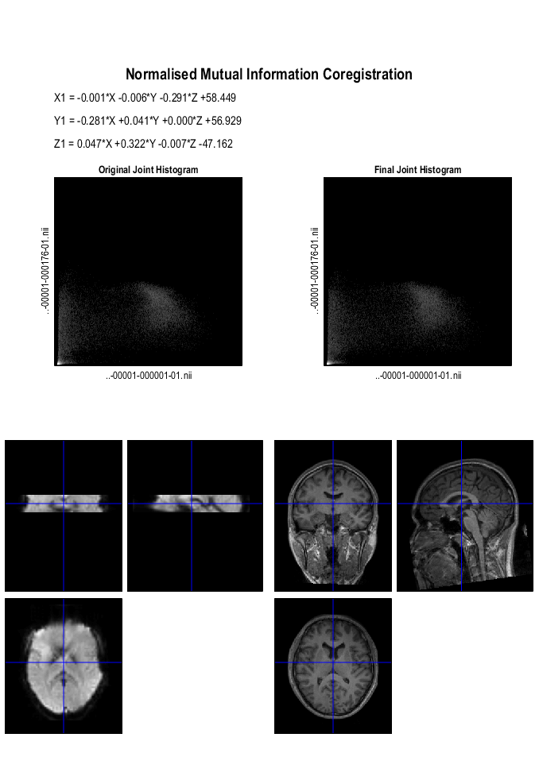
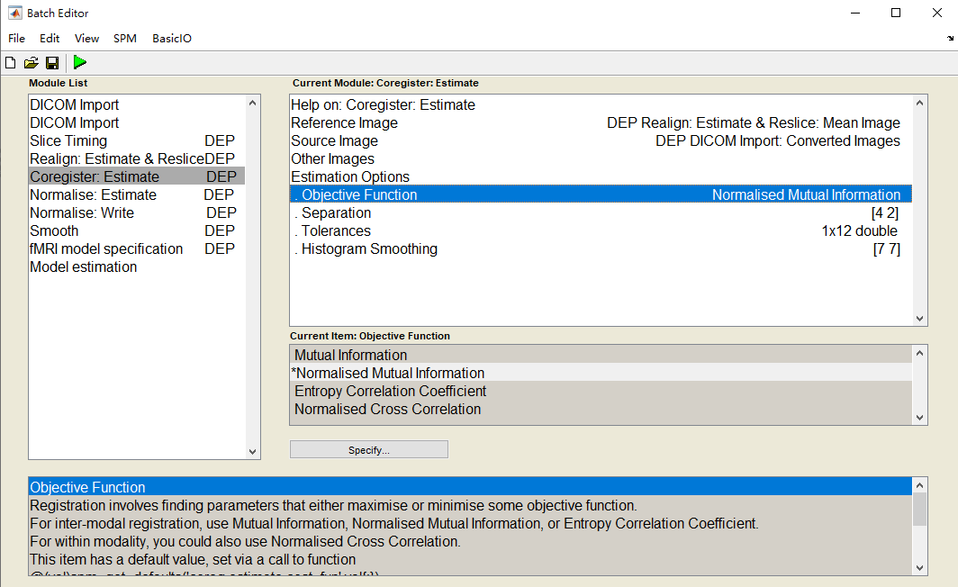
Method
Coregister

Slide 11
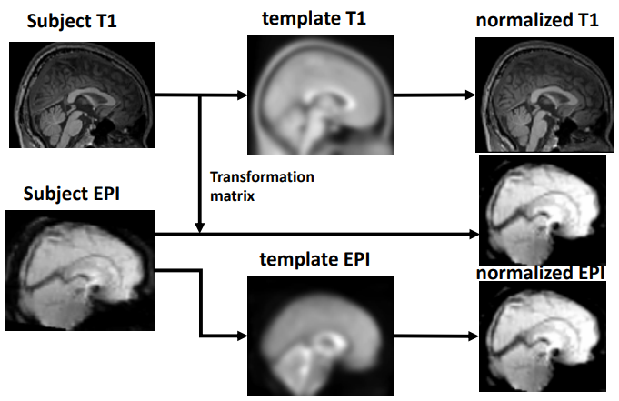
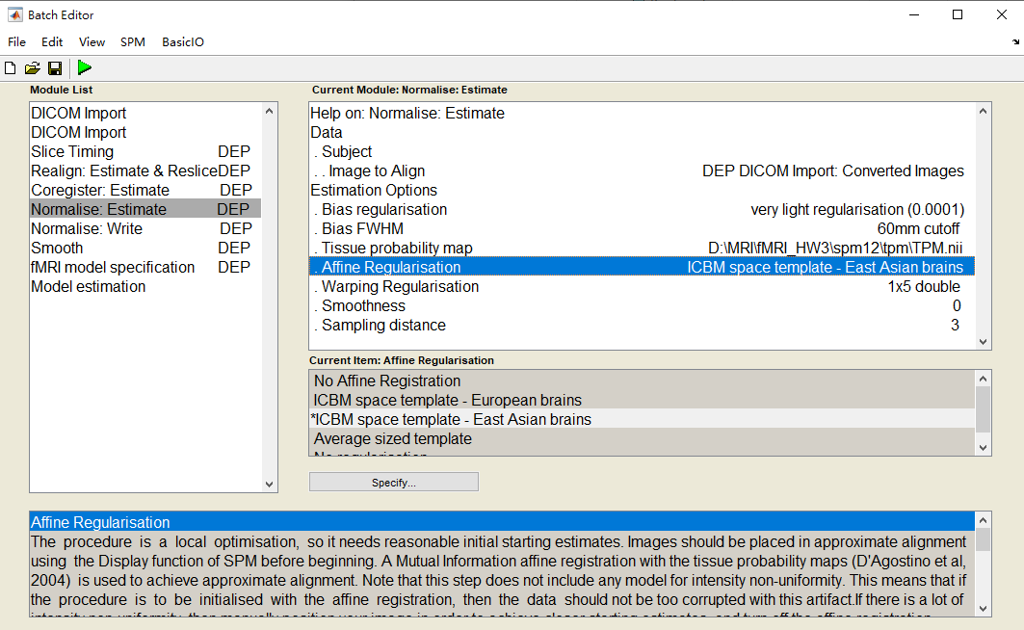
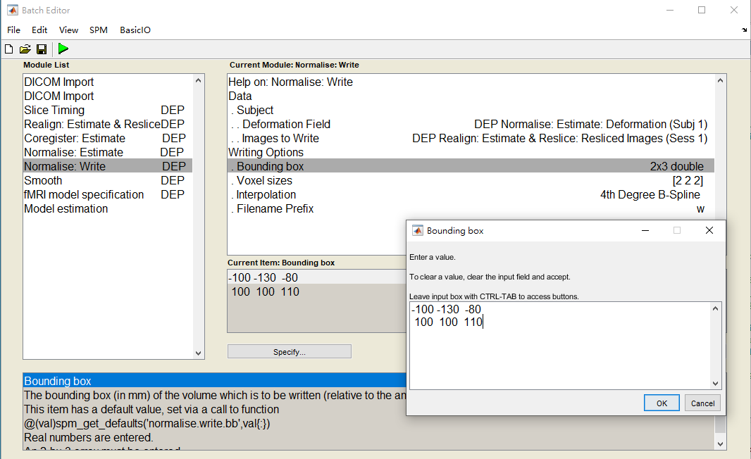
Method
Normalise

Slide 12
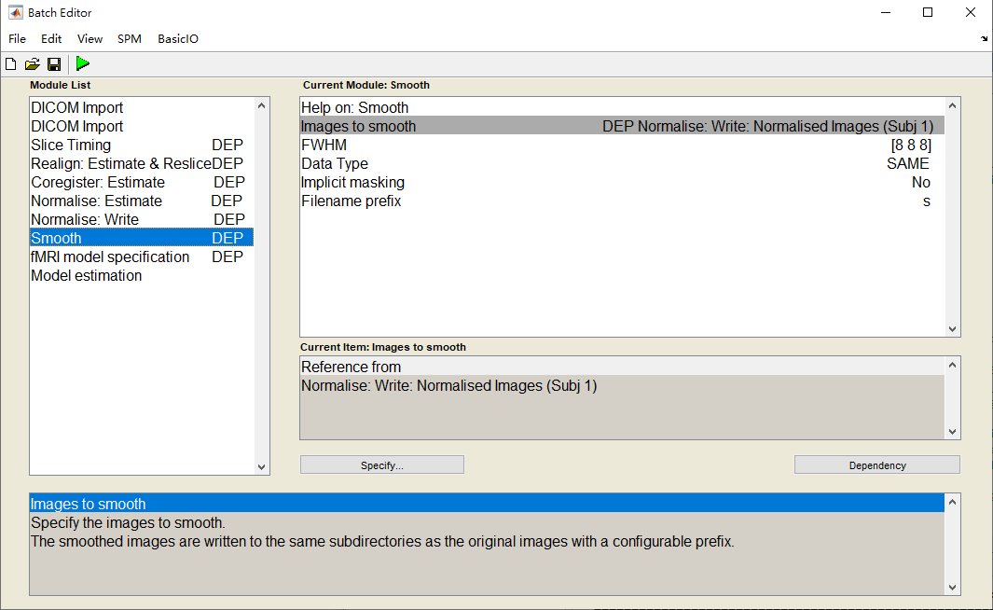
Method
Smooth

Slide 13
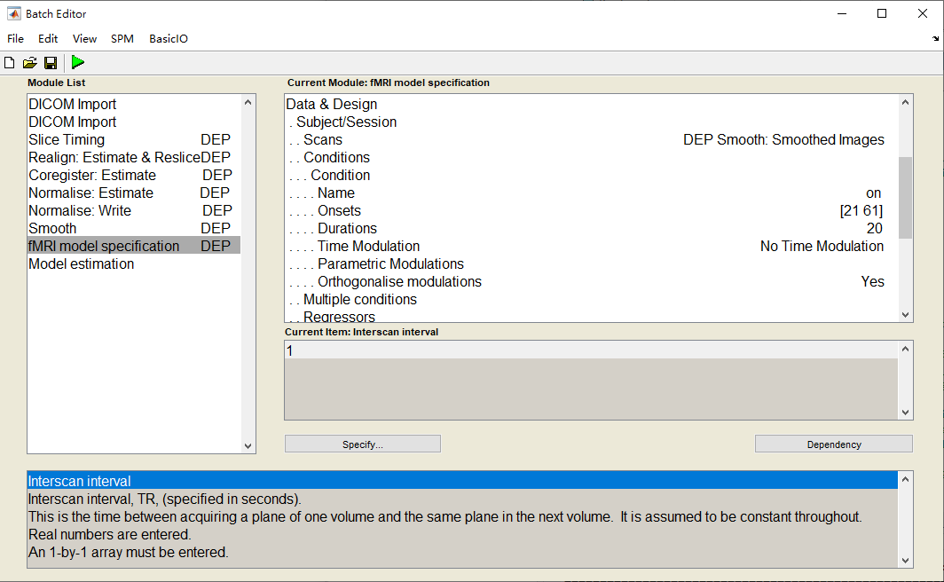
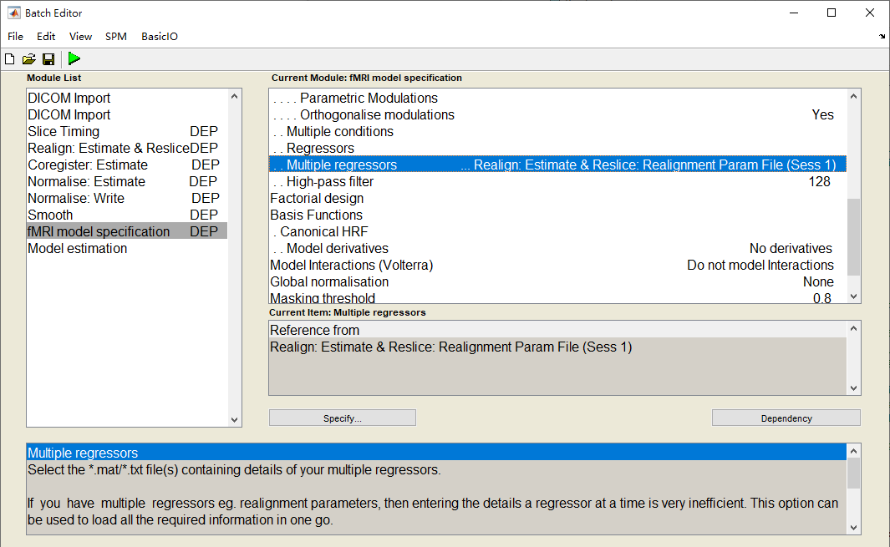
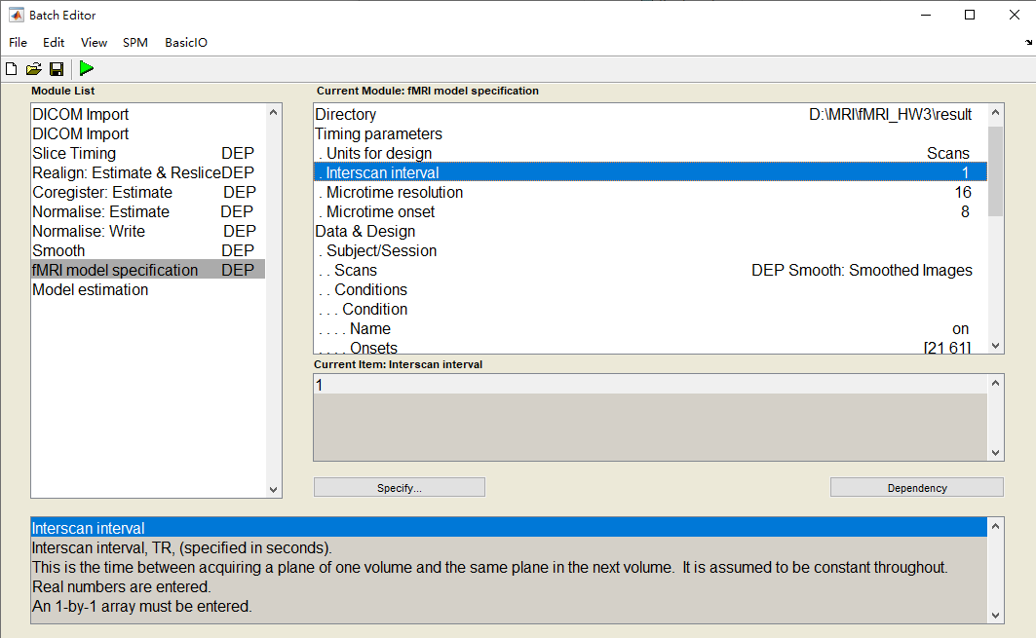
Method
fMRI Model Specification

Slide 14
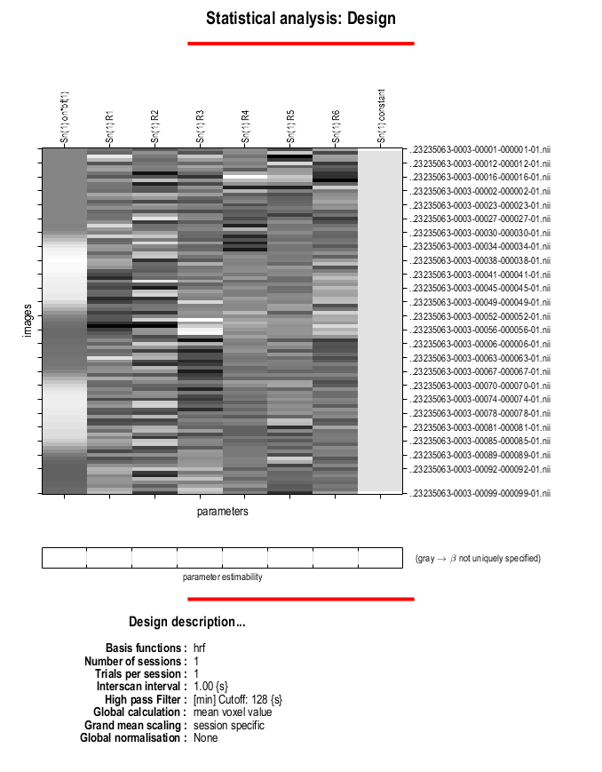
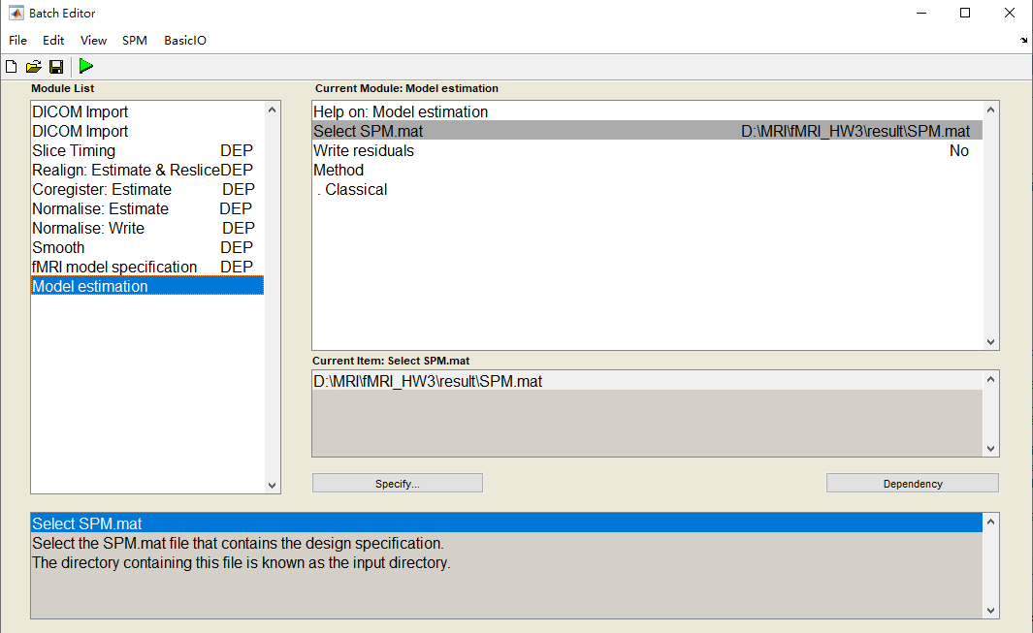
Method
Model Estimation

Slide 15
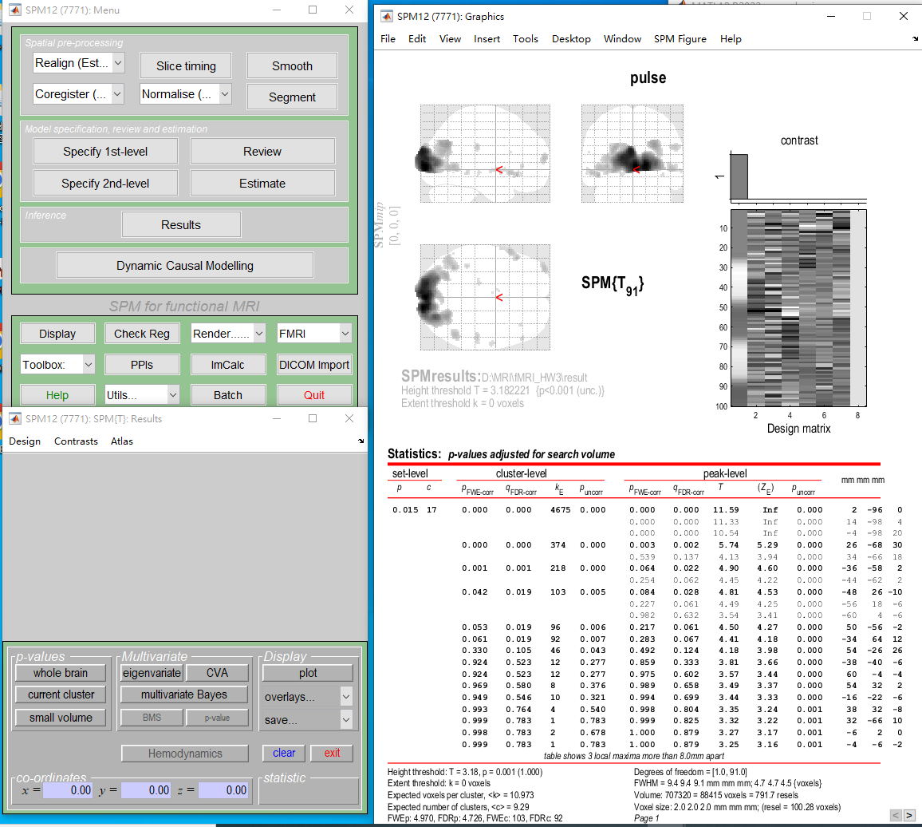
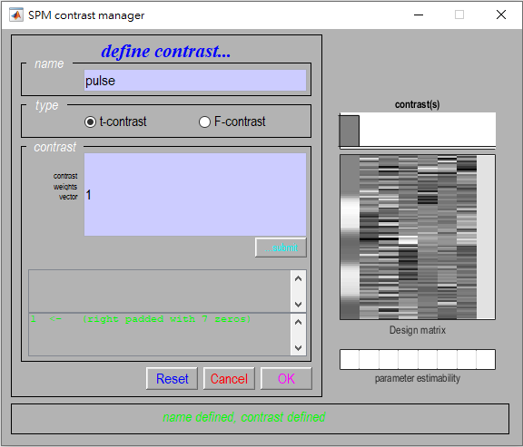
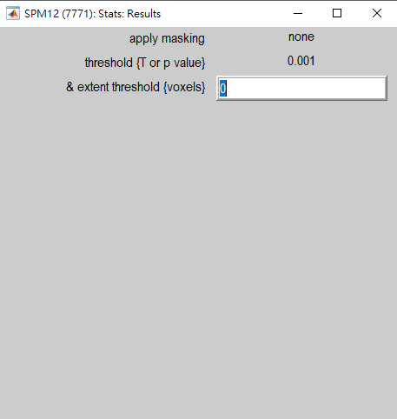
Method
Result Review

Slide 16
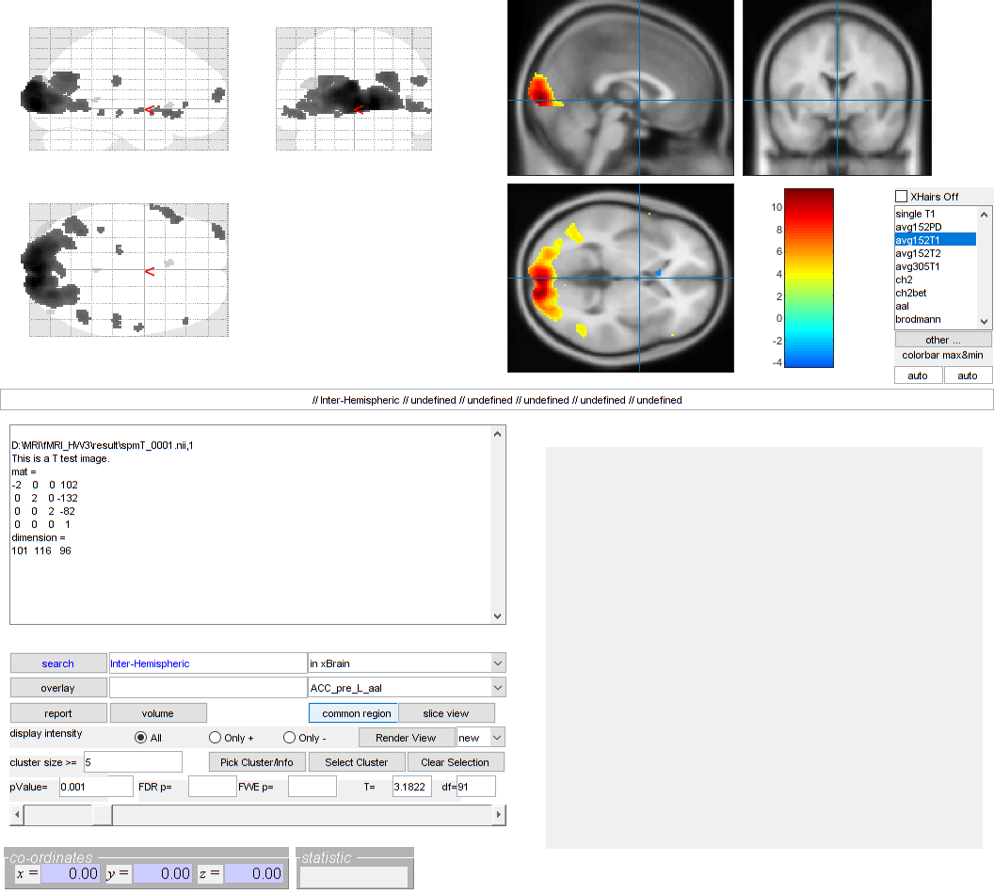
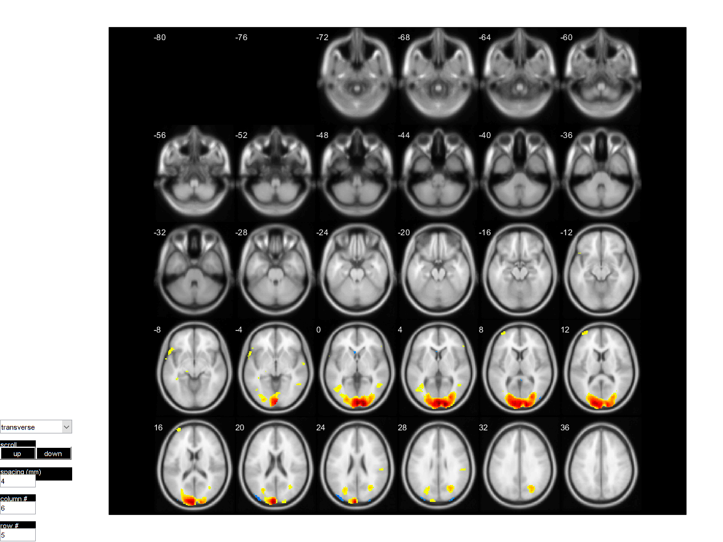
Experimental Results
xjview

